Slide 1
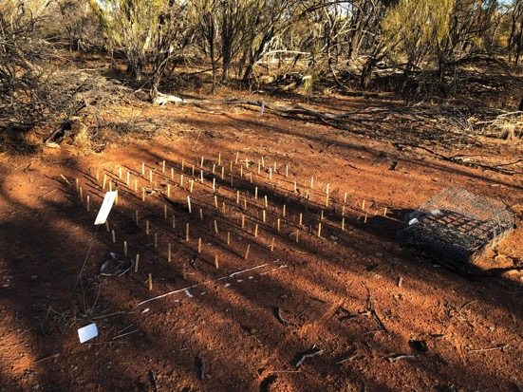
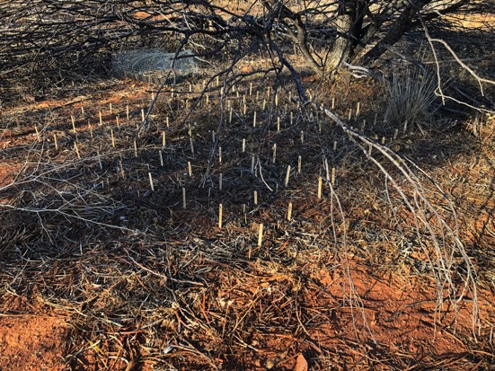
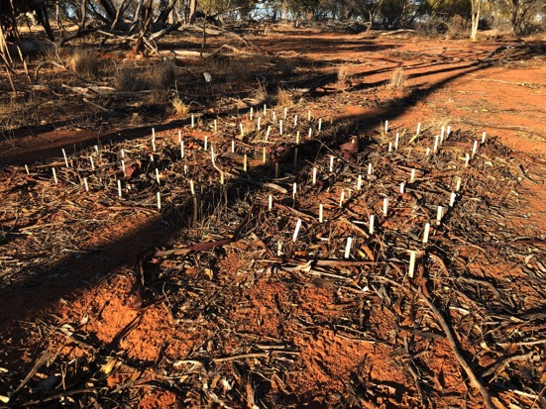
Designing rigorous surveys and experiments: REPLICATION!!!
Dr John Dwyer CONS7008

Slide 2
Strength of inference
Ability to draw conclusions about our POPULATION of interest from a SAMPLE
Ability to explain observed pattern and rule out alternatives
Requires controls, REPLICATION and randomisation

Slide 3
Replication
The inclusion of many units (e.g. tigers, bottle trees, landscapes) within observational and experimental studies to ensure that a result:
was not exceptional (a one-off / fluke)
applies more broadly than to the specific subjects measured
Replication also increases statistical power

Slide 4
Replication
Can occur at different levels:
Replication of entire studies
Replication of landscapes within studies
Replication of experimental or sampling units

Slide 5

Replication of entire studies

Slide 6
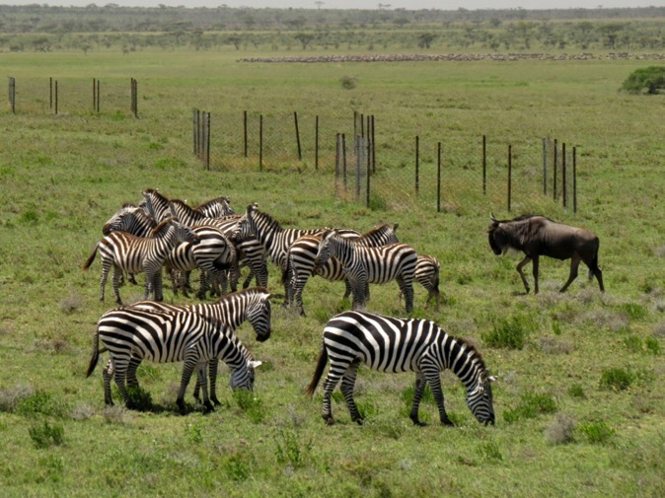
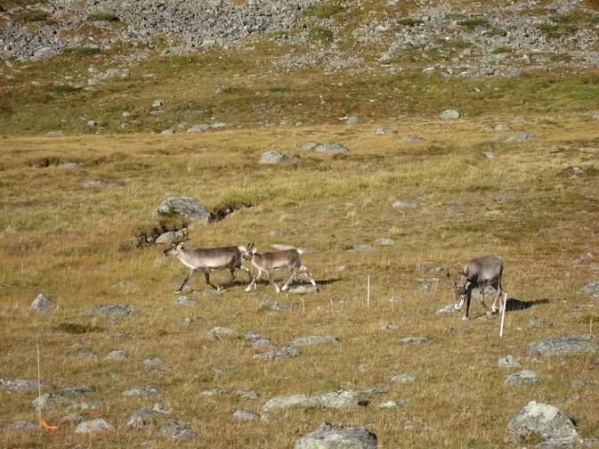
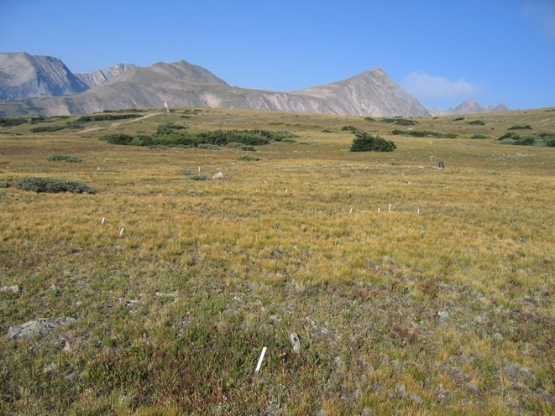

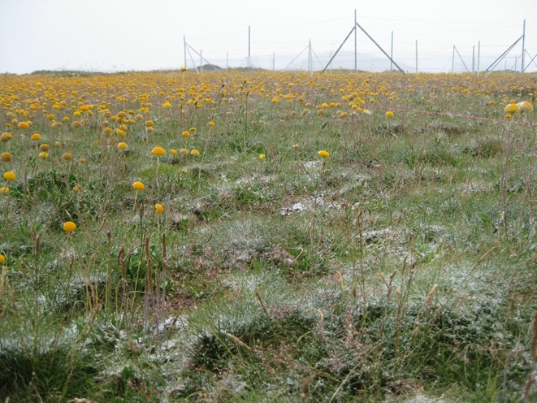

Slide 7
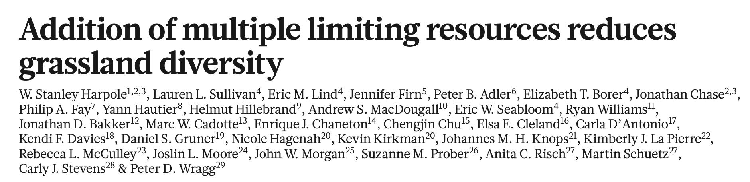
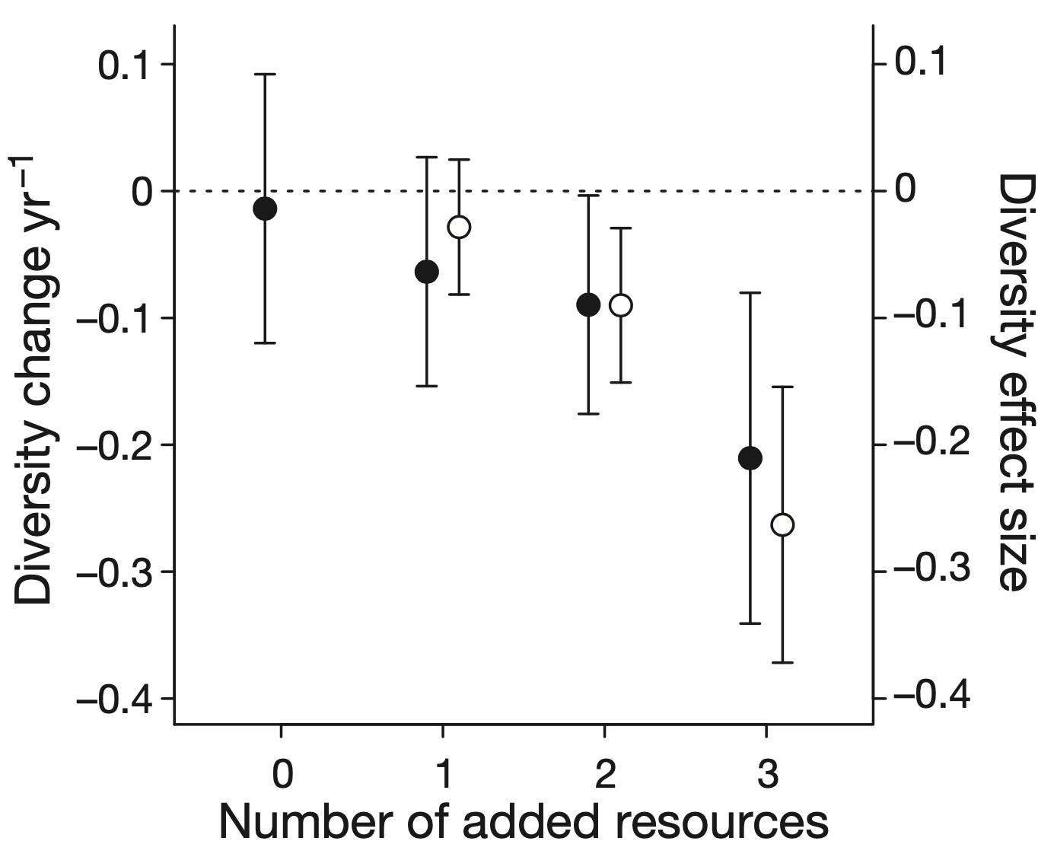

Slide 8
Can draw conclusions about grasslands GLOBALLY!!!

Slide 9
Replication of landscapes

Slide 10
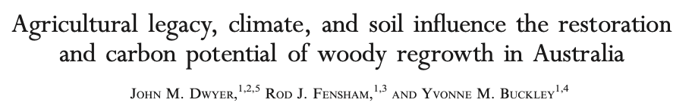
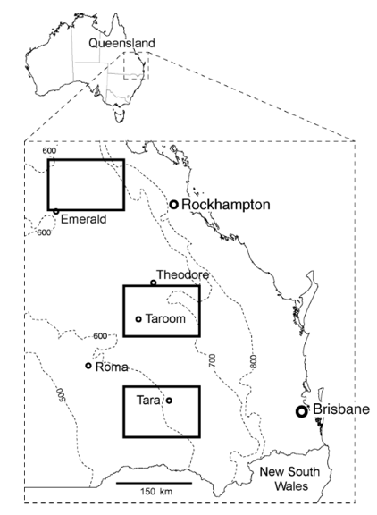

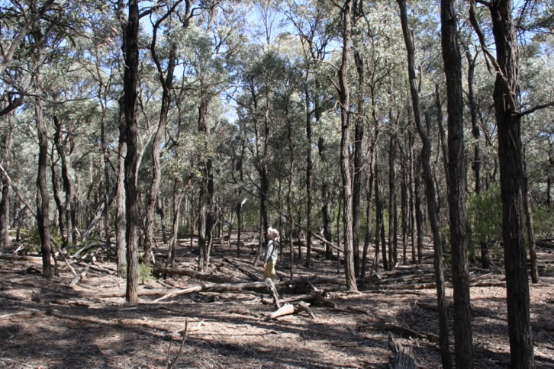

Slide 11

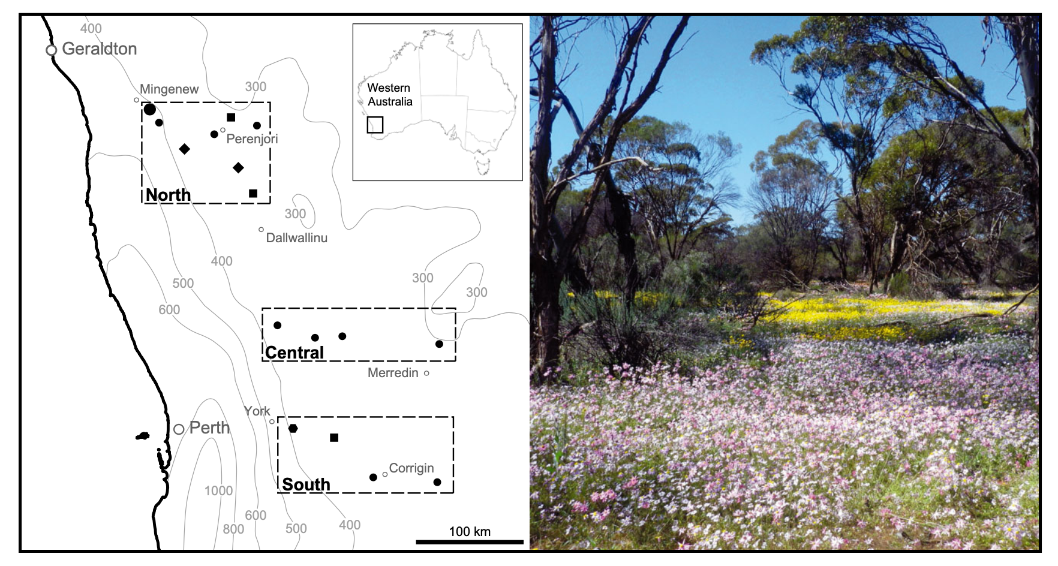

Slide 12
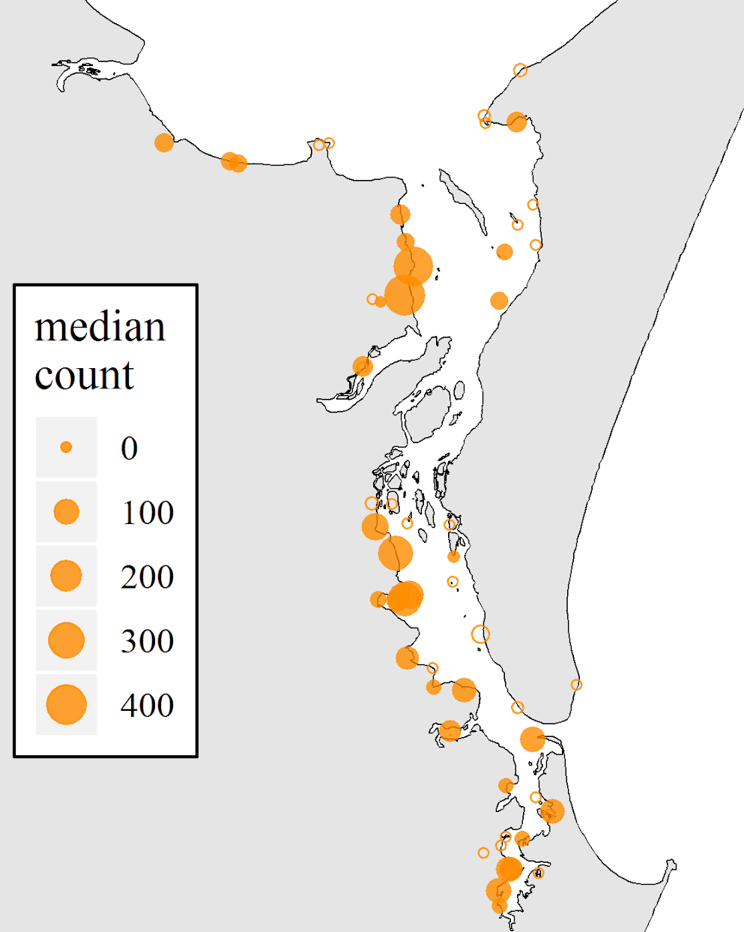
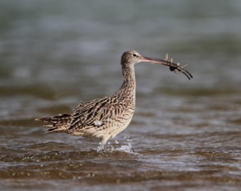
Replication of survey sites
In observational studies, each site is a replicate:
Increases precision of population parameter estimates
Requires non-biased but representative selection of sites

Slide 13
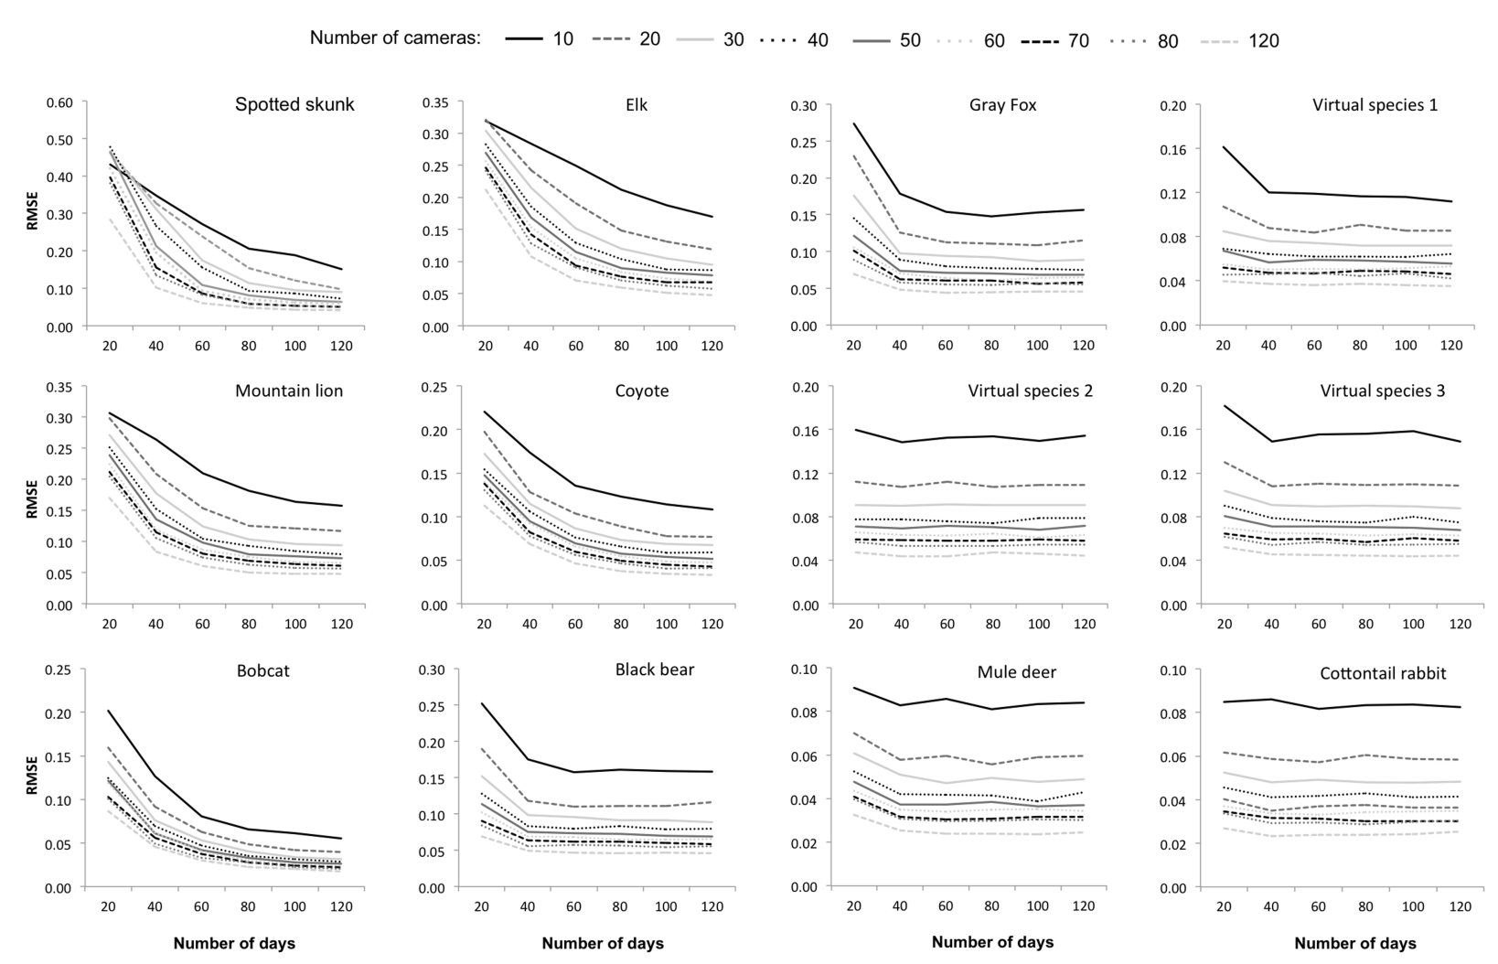
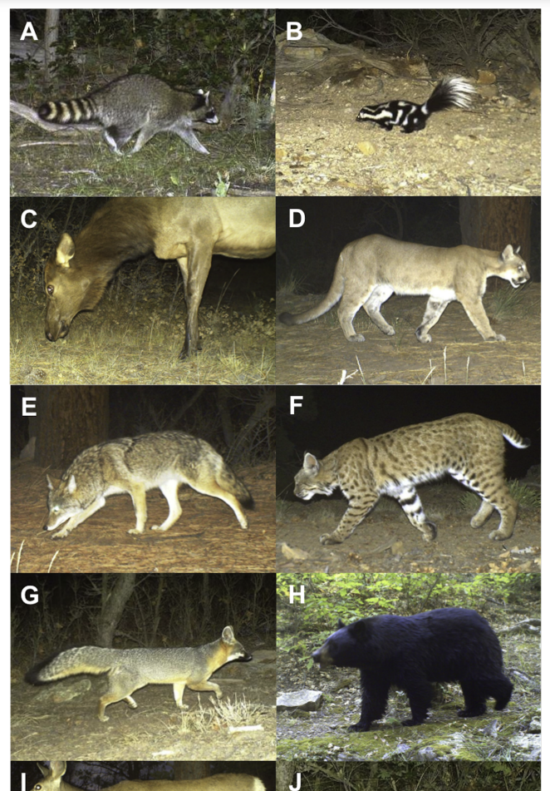

Replication of camera traps!

Slide 14
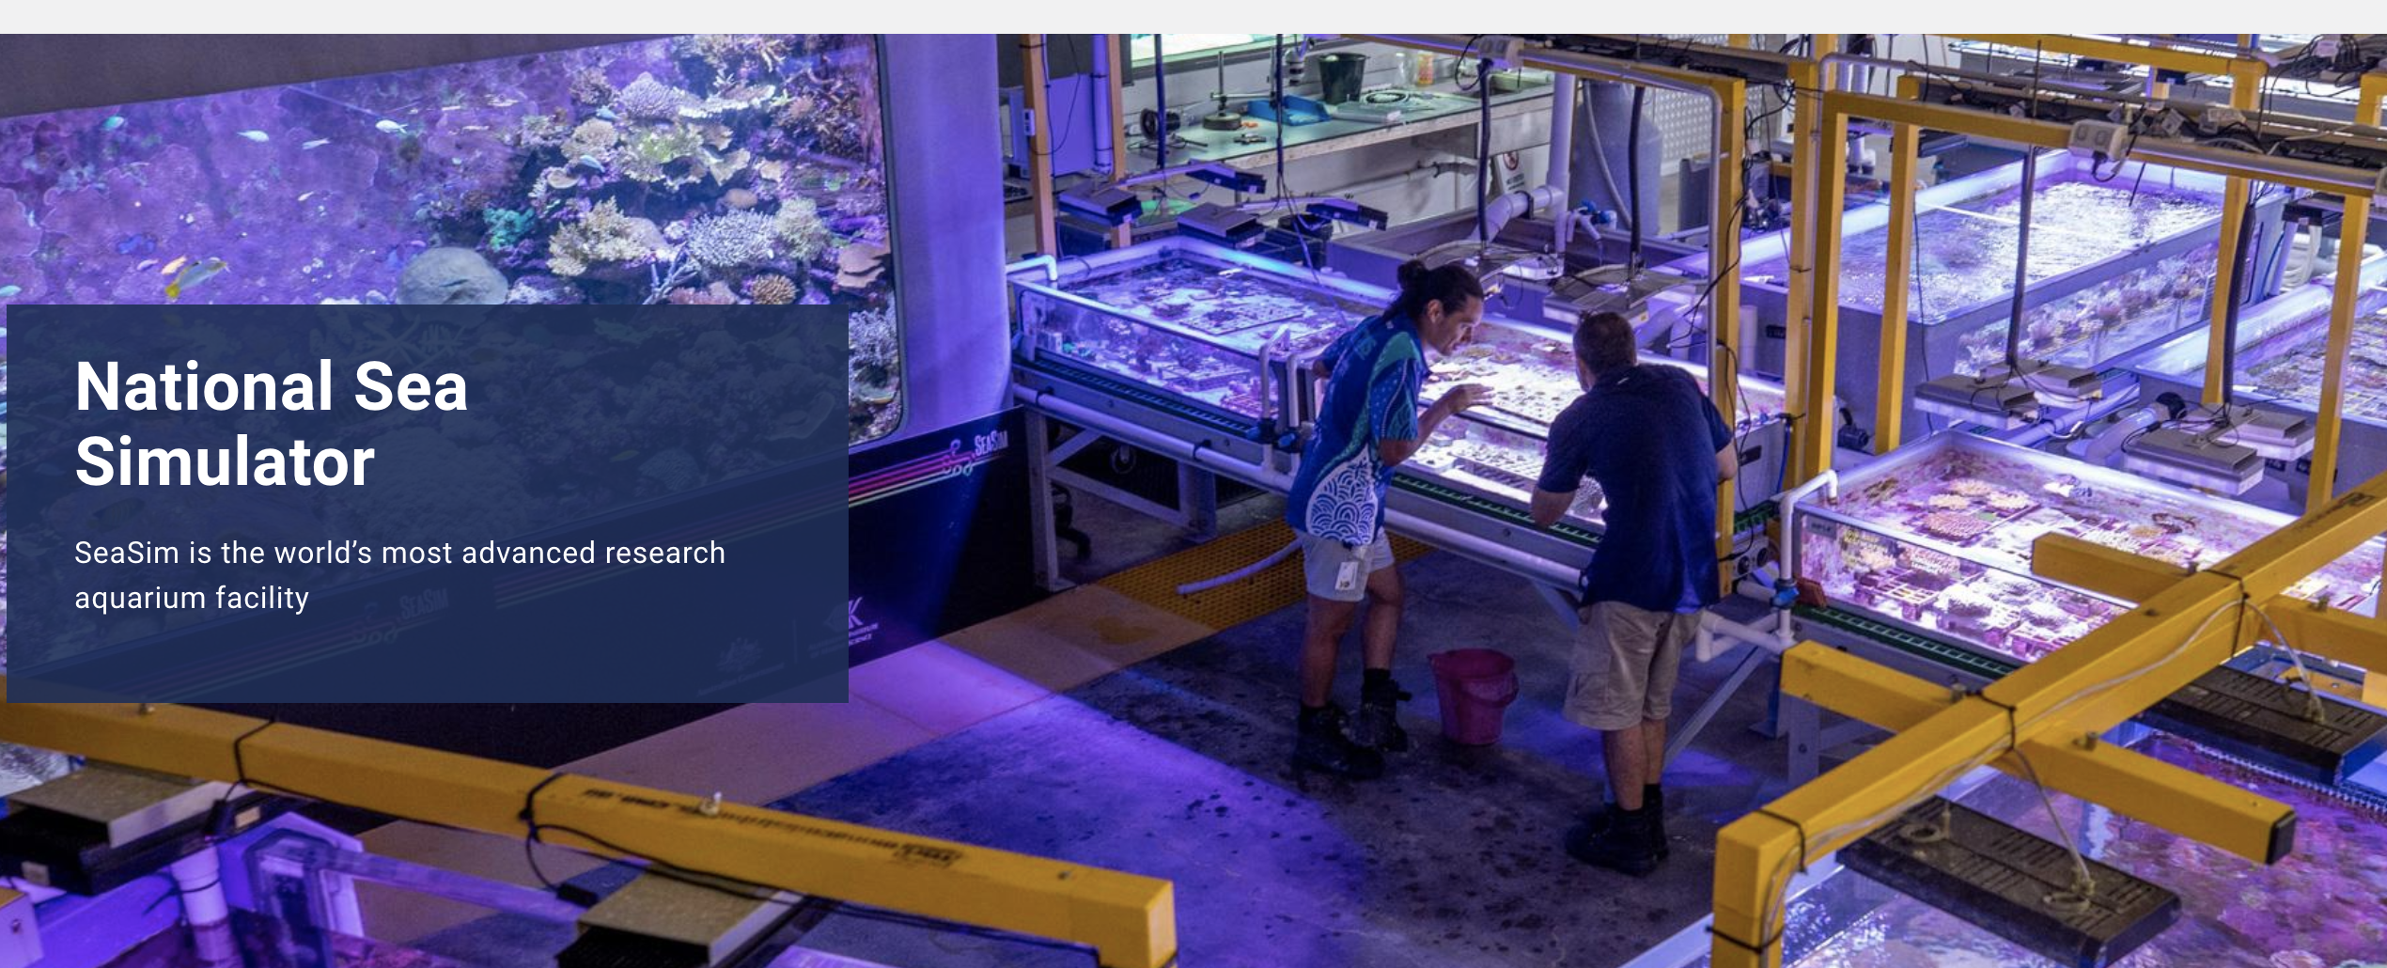
Replication of tanks!
https://www.aims.gov.au/about/facilities/national-sea-simulator/seasim-virtual-tour

Slide 15
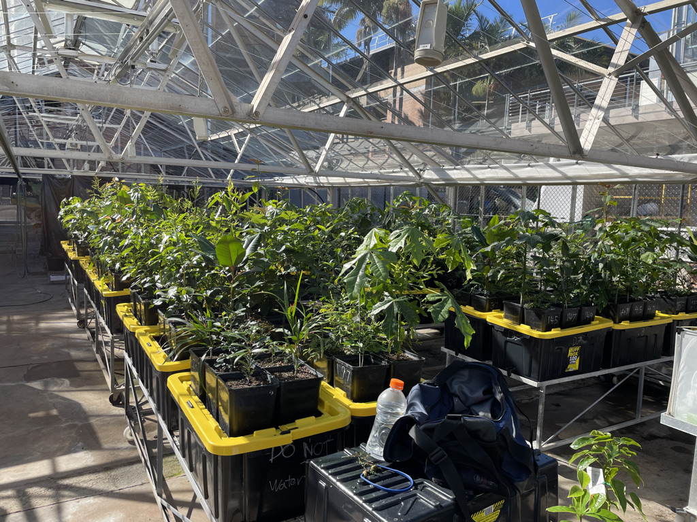
Replication of tubs!

Slide 16
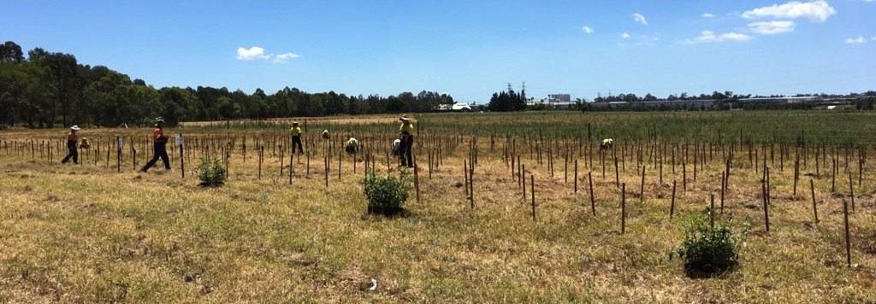
An experimental example
Experiment at Oxley Creek Common
Is it best to plant ‘fast’ or ‘hardy’ species when trying to restore subtropical rainforest?

Slide 17
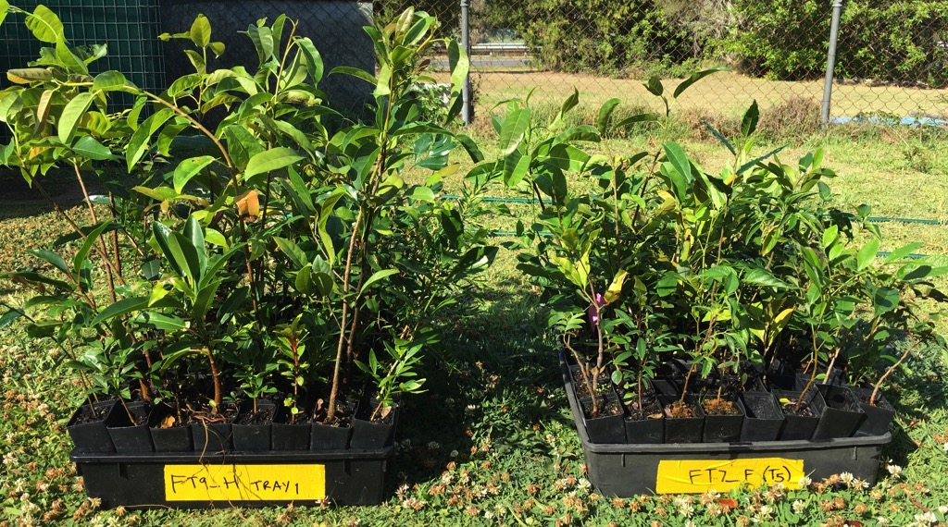
Two mixtures of species
HARDY
FAST

Slide 18
Planted in 30 x 30 m plots
400 seedlings per plot
Pairs of HARDY and FAST plots were repeated along the corridor – WHY???

Slide 19
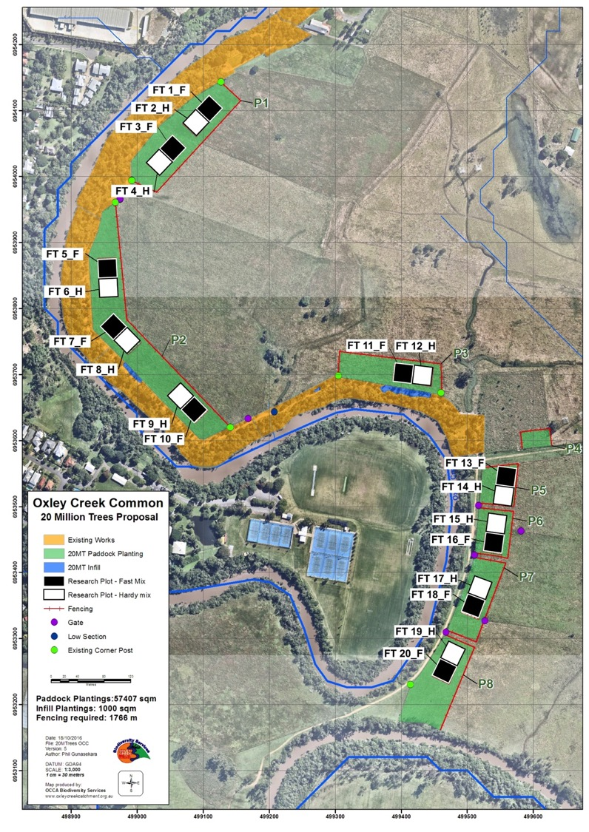

Slide 20
Repeated measures
Repeated measures = multiple observations of a single unit:
Improves estimate of mean and provides estimate of variance before and after treatment
Useful for understanding effect of the treatment on both mean and variance of response, and the size of the effect relative to the variance
Repeated measures ≠ replication!!!

Slide 21
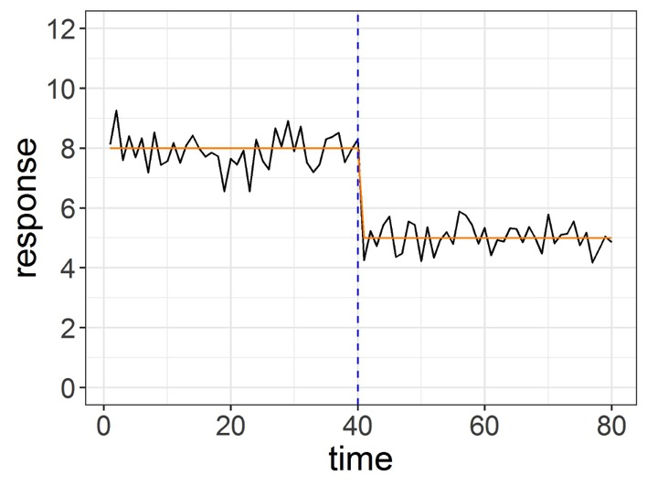
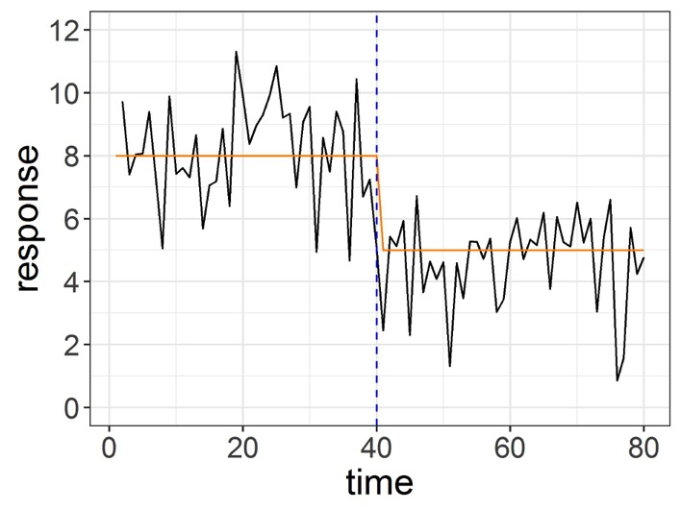
Repeated measures

Slide 22
Independence
Definition: the response of one experimental (or survey) unit does not affect the response of another unit
Lack of independence can arise for many reasons, such as:
repeated measures on sampling or experimental units
observations are correlated in time
observations are correlated in space

Slide 23
Pseudo-replication
This is a problem but can be dealt with
More on this later…

Slide 24
Key points
Replication helps establish that a result:
was not exceptional (a one-off / fluke)
applies more broadly than to the specific subjects measured
In general, more replicates = greater power to detect treatment effects
Try to separate replicates by enough space (or time) so that conditions at one replicate are not influenced by (or correlated with) conditions at the others

Slide 25
Coming up
Thursday 1pm Workshop: Understanding linear regression
Thursday 5pm Lecture (Rich Fuller): Species distributions II
Pre-recorded stats lecture: Linear models (regression)
Friday R Prac: Linear models (regression)

